Slide 1
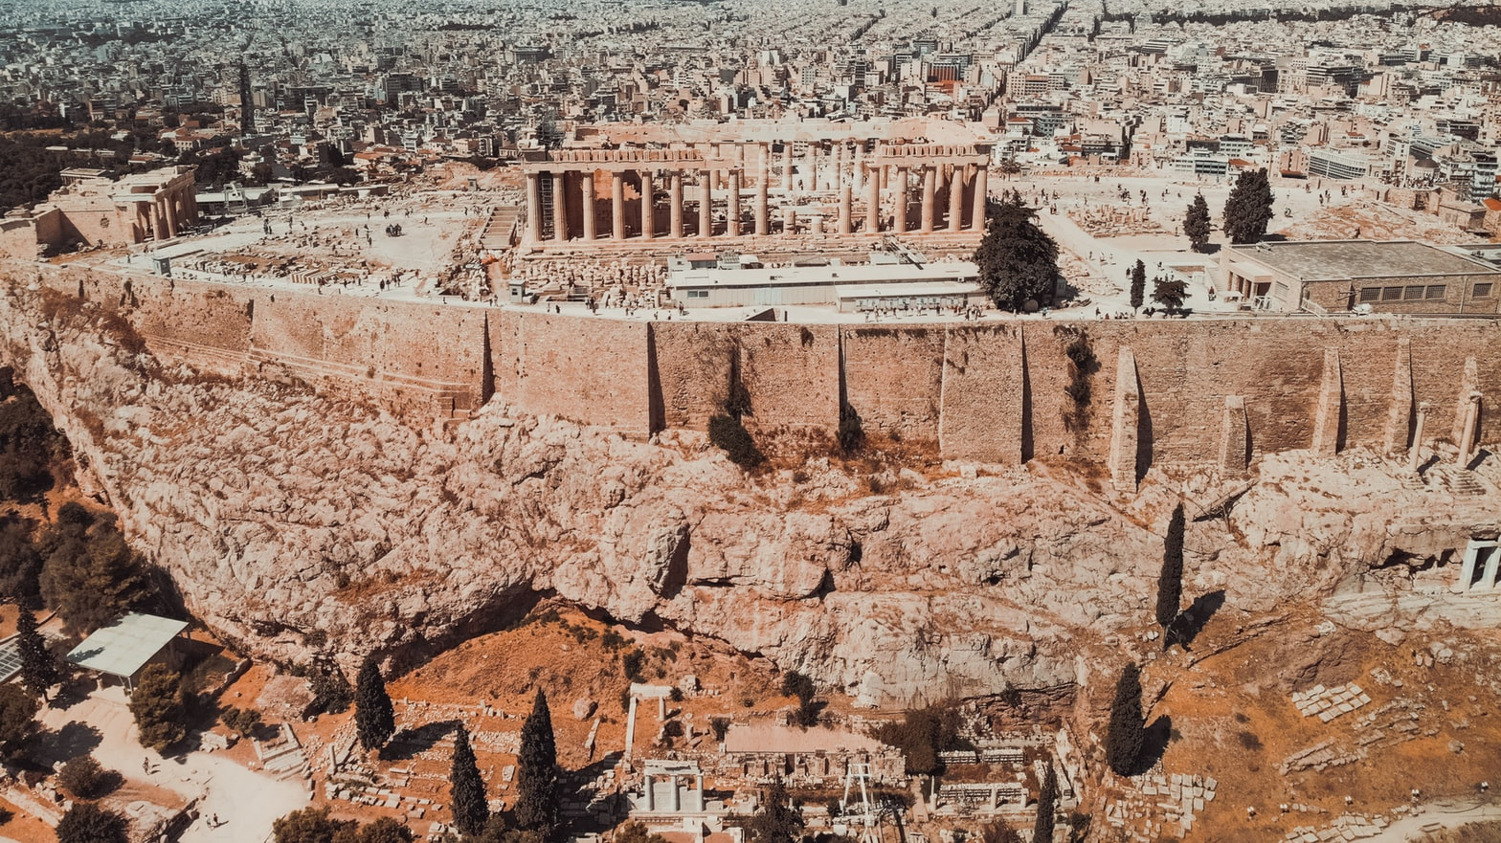
IBM Data Science Professional Certificate
Opening a Restaurant in Attica

Slide 2
Table of Contents
Introduction
Data Description
Methodology
Results
Conclusion

Slide 3
1. Introduction
An entrepreneur is considering to open a Restaurant in Attica, Greece.
Entrepreneur Preferences:
He wants to try something different from the traditional Greek cuisine and specifically his preferences are the Mexican, Italian, Middle East, Indian and Sushi gastronomies.
He has bias for Kifissia, Filadelpheia and Marousi Boroughs.

Slide 4
2. Data Description
Τhe data that will be used to complete the Opening a Restaurant in Attica project will include:
The list of all Municipalities in Attica on the network which will be scraped from Wikipedia. Consequently, from this list we will be able to extract the latitude and longitude of each Municipality. Furthermore, after this step we will plot the locations on a map.
The Foursquare dataset from which we will have access to all venues from Attica and their location with the latitude and longitude coordinates.

Slide 5
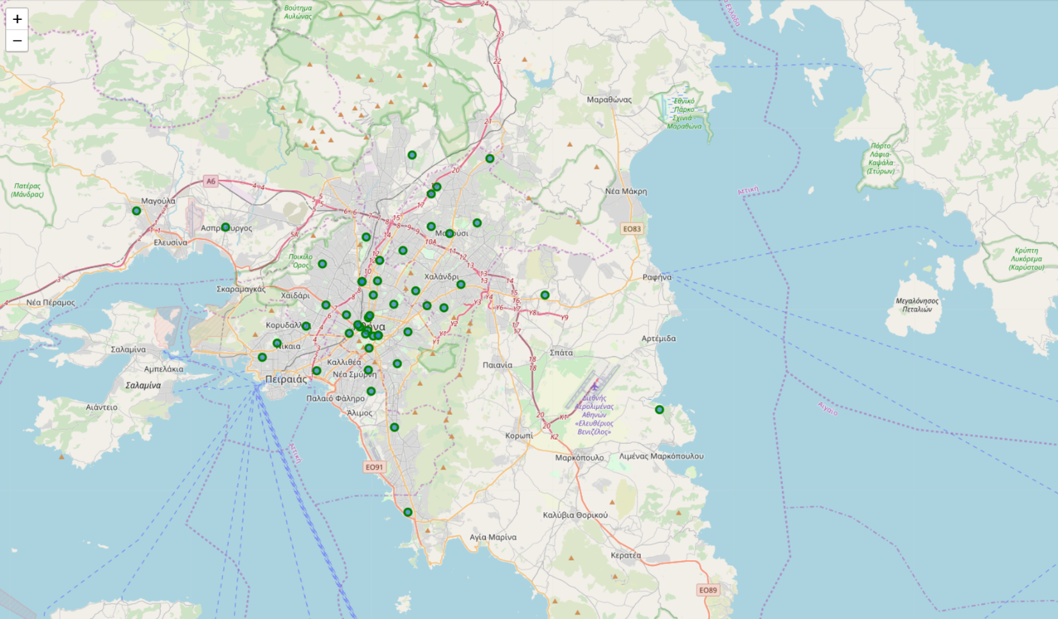
3. Methodology
Using The Table: https://commons.wikimedia.org/wiki/Category:Municipalities_in_Attica and the library BeautifulSoup for Data wrangling.
Using the library Geocoder for the geographical coordinates.
Using Foursquare API to get all the venues that are within the radius of 2000 meters from our geographical locations.
Data processing.

Slide 6
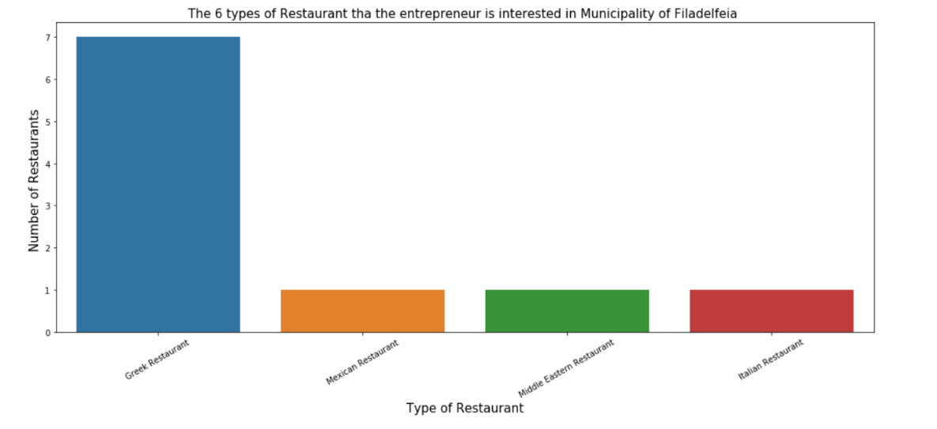
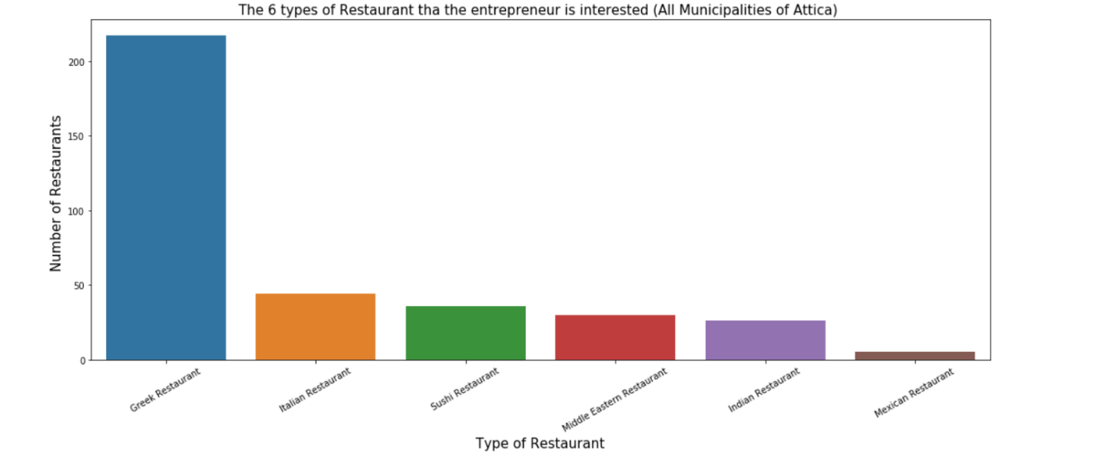
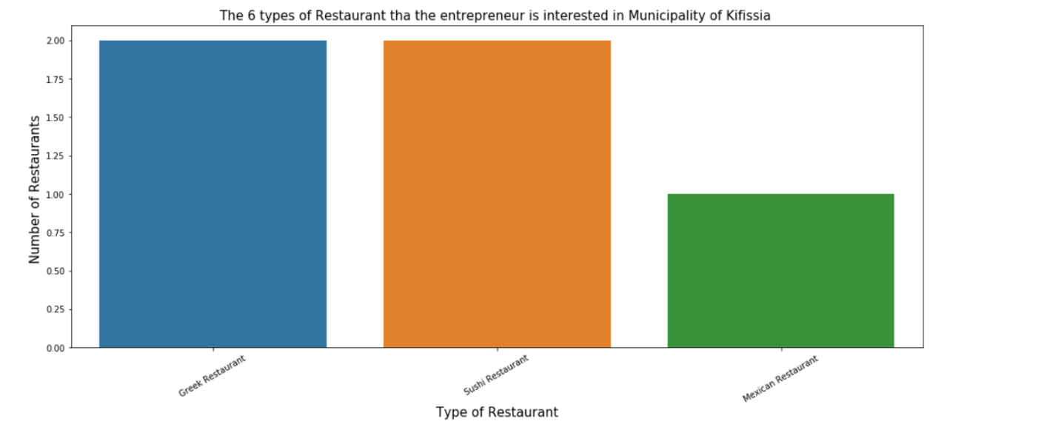
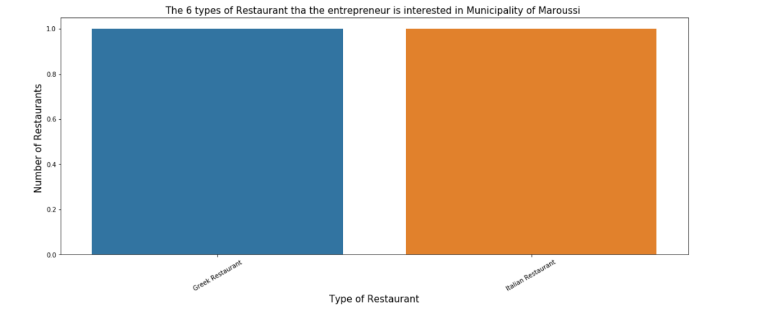
4. Results
Lack of Mexican restaurants in the Attica region.
Municipality of Marousi does not have a Mexican Restaurant as opposed to the municipalities of Kifissia and Filadelpheia.

Slide 7
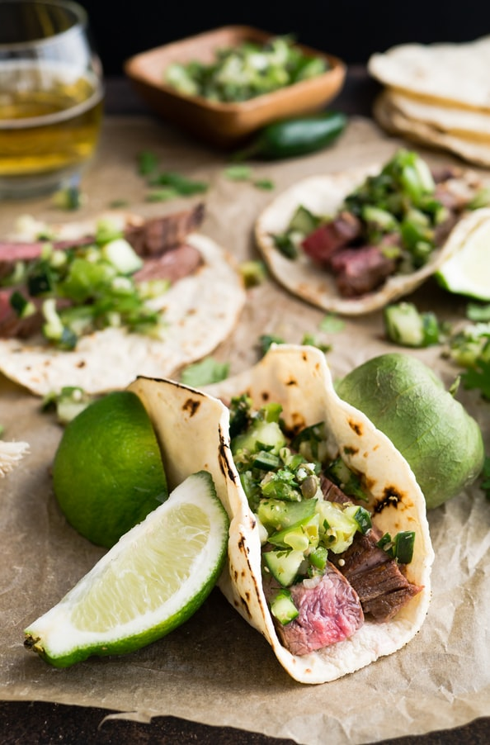
Conclusion
The best option for the entrepreneur is to open a Mexican restaurant in the Municipality of Maroussi.
The Borough of Marousi has population of 72,333 inhabitants according to the 2011 census and is not very far from the centre of Athens.
before the construction of the Mexican Restaurant, it is imperative to research how the existing Mexican Restaurants respond to the market.

